Slide 1
CS112: Introduction to Python programming
Function

Slide 2
Code modularization （模块化）
Codes can be difficult to manage for complex programs
Code modularizing is a way to increase code re-usability and readability
Python provides several ways to modularize the source code: functions, modules, packages, and classes.

Slide 3
Functions (函数)
Functions are used when you have a block of statements that needs to be executed multiple times within the program.
This block of statements are grouped together and is given a name which can be used to invoke it from other parts of the program (function calling).
Functions also reduce the size of the program by eliminating rudimentary code.

Slide 4
Functions (函数)
A function takes values (called arguments or parameters), executes some operation based on them and returns a value (not always).
Functions can be either built-in functions or user-defined functions

Slide 5
Built-in functions
The Python interpreter has a number of functions that are built into it and are always available:
>>> abs(-3)
3
>>> min(1, 2, 3, 4, 5)
1
>>> max(4, 5, 6, 7, 8)
8
>>> divmod(5, 2)
(2, 1)
>>> pow(3, 2)
9
>>> len("Japan")
5
Calling help() prints help for the python object.

Slide 6
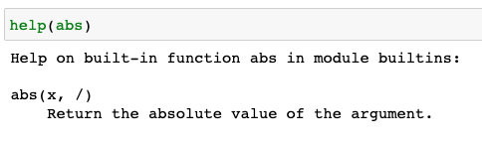
Built-in functions
The Python interpreter has a number of functions that are built into it and are always available:
>>> abs(-3)
3
>>> min(1, 2, 3, 4, 5)
1
>>> max(4, 5, 6, 7, 8)
8
Calling help() prints help for the python object.

Slide 7
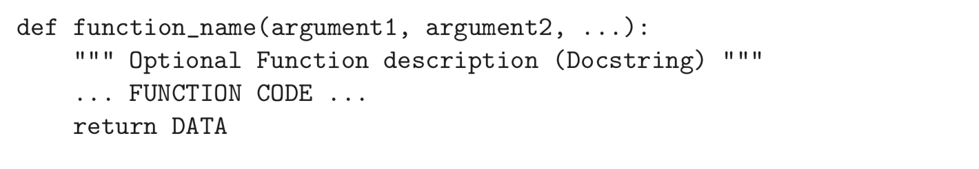
User-defined functions
User-defined functions are reusable code blocks created by users to perform some specific task in the program:
Define a function: using def

Slide 8
User-defined functions
A function definition consists of the def keyword, followed by:
1. The function name: use letters, numbers, or an underscore, but the name cannot start with a number.
PEP8: function names should be lowercase with words separated by underscores.

Slide 9
User-defined functions
A function definition consists of the def keyword, followed by:
2. A list of arguments/parameters（参数） enclosed in "()" and separated by ",". Some functions may not have parameters
You can send any data types of argument to a function (string, number, list, dictionary etc.), and it will be treated as the same data type inside the function.

Slide 10
User-defined functions
A function definition consists of the def keyword, followed by:
3. A colon at the end of the function header
4. Block of statements that define the body of the function start and they must have the same indentation level

Slide 11
User-defined functions
The first statement among the block of statements can optionally be a documentation string or docstring （文档字符串）:
""" This is single line docstring """
OR
""" This is
multiline
docstring """

Slide 12
User-defined functions
A function can return only a single value, but that value can be a list or tuple
When returning multiple values, separating them by a comma will by default construct a tuple by Python
If you want to return a value using return statement from the function definition, then you have to assign the result of the function to a variable

Slide 13
User-defined functions
It is possible to define functions without a return statement. Functions like this are called void functions, and they return None

Slide 14
Calling function
The syntax for function call or calling function is:
Arguments are the actual value that is passed into the calling function. There must be a one-to-one correspondence between the parameters in the function definition and the actual arguments of the calling function
A function should be defined before it is called and the block of statements in the function definition are executed only after calling the function
function_name(arg_1, arg_2,…,arg_n)

Slide 15
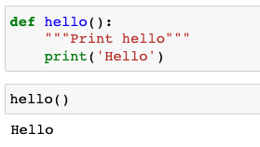
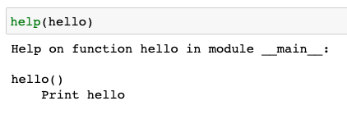
Write your first function
Write a function to print hello

Slide 16
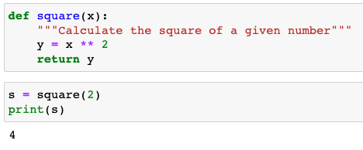
Write your first function
Write a function to calculate the square of a given number

Slide 17
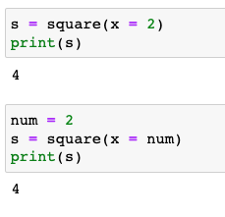
Write your first function
Write a function to calculate the square of a given number

Slide 18
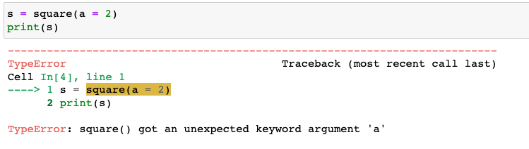
Write your first function
Write a function to calculate the square of a given number

Slide 19
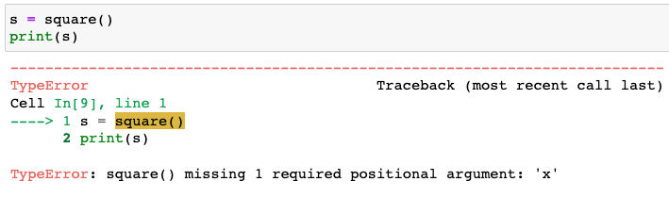
Write your first function
Write a function to calculate the square of a given number

Slide 20
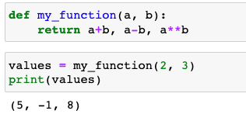

Functions with multiple arguments and return values
Write a function to calculate a+b, a-b and a^b for given numbers a and b
tuple unpacking

Slide 21
Positional and keyword arguments
Python provides different ways of passing the arguments during the function call, including positional arguments and keyword arguments.
Positional arguments are passed without parameter names but in the order we have defined function parameters. If you change the argument positions, you may get the unexpected output.
We should use positional arguments whenever we know the order of argument to be passed.

Slide 22

Positional arguments

Slide 23
Positional and keyword arguments
Keyword arguments are passed by their parameter names at the time of calling the function in the form kwarg = value.
All the keyword arguments passed must match one of the parameters in the function definition and their order is not important.
No parameter in the function definition may receive a value more than once

Slide 24
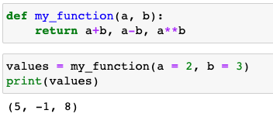

Keyword arguments

Slide 25
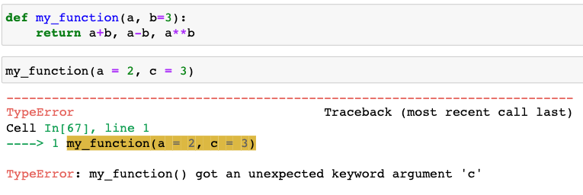
Keyword arguments

Slide 26
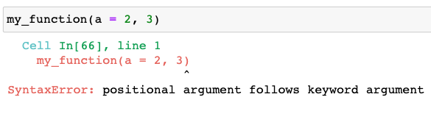
Positional and keyword arguments
When using a mix of positional and keyword arguments, keyword arguments must follow positional arguments

Slide 27
Positional and keyword arguments
Positional Argument | Keyword Argument
Arguments are passed in the order of parameters. The order defined in the order function declaration. | Parameter Names are used to pass the argument during the function call.
Order of values cannot be changed to avoid the unexpected output. | Order of parameter Names can be changed to pass the argument(or values).

Slide 28
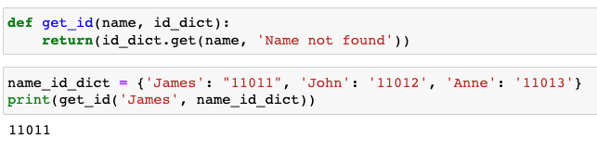
Functions with multiple arguments and return values
You can send any data types of argument to a function (string, number, list, dictionary etc.), and it will be treated as the same data type inside the function.
e.g. write a function to get id of a given name and id dictionary

Slide 29
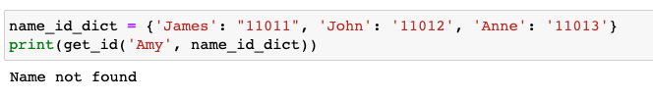
Functions with multiple arguments and return values
You can send any data types of argument to a function (string, number, list, dictionary etc.), and it will be treated as the same data type inside the function.
e.g. write a function to get id of a given name and id dictionary

Slide 30
Passing mutable and immutable objects as arguments
Changes to immutable arguments (e.g. numbers, strings and tuples ) of a function within the function do not affect their values in the calling program.
Changes to mutable arguments (e.g. lists and dictionaries) of a function within the function also change the values of the same objects in the calling program

Slide 31
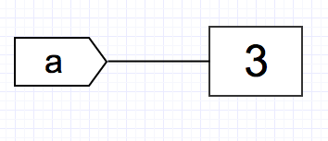
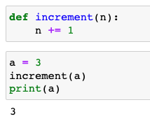
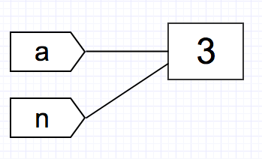
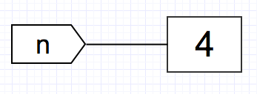
Passing mutable and immutable objects as arguments
n +=1
integer is immutable, create a new object with the value 4
a is still referring to the same object

Slide 32
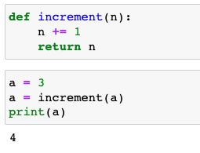
Passing mutable and immutable objects as arguments
a now refers to the new object created by the function

Slide 33
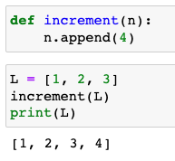
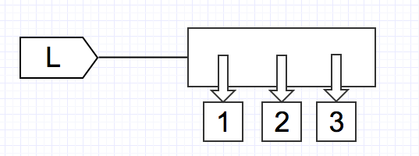
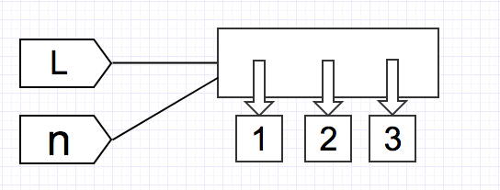
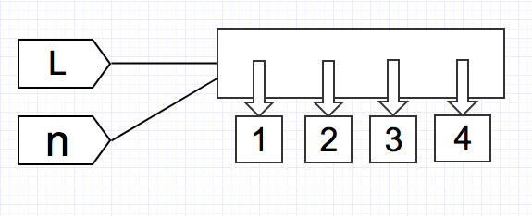
Passing mutable and immutable objects as arguments
The .append() method modifies the list in place, since list is mutable:
L is changed!

Slide 34
Passing mutable and immutable objects as arguments
def test(t):
t = (1, 2)
return t
t = (3, 4)
t1 = test(t)
print(t)
print(t1)
def test(a):
a[-1] = "end"
return a
a = [1, 2]
a1 = test(a)
print(a)
print(a1)

Slide 35
Passing mutable and immutable objects as arguments
def test(t):
t = (1, 2)
return t
t = (3, 4)
t1 = test(t)
print(t)
print(t1)
def test(a):
a[-1] = "end"
return a
a = [1, 2]
a1 = test(a)
print(a)
print(a1)
(3, 4)
(1, 2)
[1, 'end']
[1, 'end']

Slide 36
Arguments with default values
Python allows default values in the arguments. This is done by entering the default value in the function definition
Any calling function must provide arguments for all required parameters in the function definition but can omit arguments for default parameters. If no argument is sent for that parameter, the default value is used

Slide 37
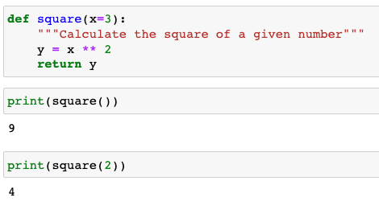
Arguments with default values

Slide 38
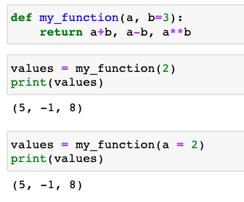
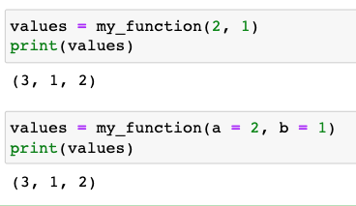
Arguments with default values
Usually, the default parameters are defined at the end of the parameter list

Slide 39
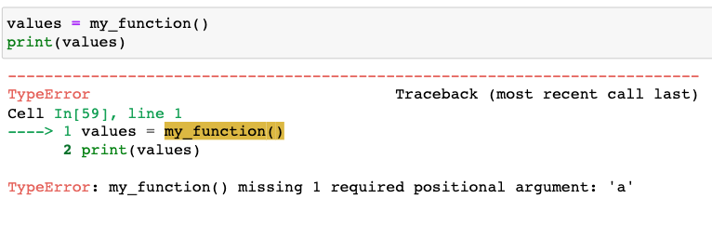
Arguments with default values
Usually, the default parameters are defined at the end of the parameter list

Slide 40
Arbitrary argument (可变参数):*args and **kwargs
*args and **kwargs allow you to pass a variable number of arguments to the function definition. It is very useful when user does not know in advance about how many arguments will be passed to the function definition
*args as parameter in function definition allows you to pass a non-keyworded & variable length tuple argument list to the function definition
**kwargs as parameter in function definition allows you to pass keyworded & variable length dictionary argument list to the function definition

Slide 41
*args and **kwargs
*args must come after all the positional parameters and **kwargs must come right at the end
The single asterisk (*) and double asterisk (**) are the important elements here and the words args and kwargs are used only by convention. The Python does not enforce those words and the user is free to choose any words of their choice

Slide 42
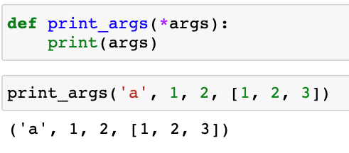
*args

Slide 43
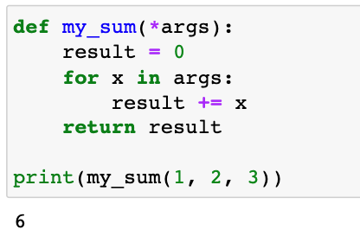
*args
In this example, you’re not passing a list to my_sum(). Instead, you’re passing three different positional arguments.
my_sum() takes all the parameters that are provided in the input and packs them all into a single iterable object named args.
Note that args is just a name. You’re not required to use the name args. You can choose any name that you prefer.

Slide 44
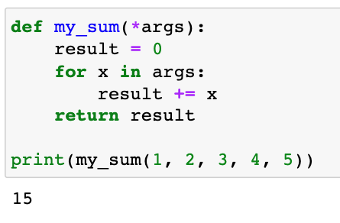
*args
In this example, you’re not passing a list to my_sum(). Instead, you’re passing three different positional arguments.
my_sum() takes all the parameters that are provided in the input and packs them all into a single iterable object named args.
Note that args is just a name. You’re not required to use the name args. You can choose any name that you prefer.

Slide 45
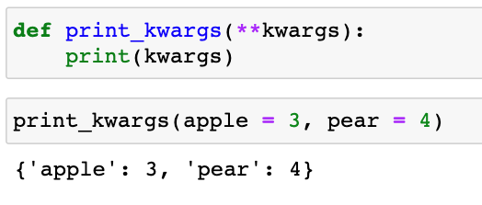
**kwargs
Like *args, **kwargs can take however many arguments you would like to supply to it. However, **kwargs differs from *args in that you will need to assign keywords.
A dictionary called kwargs is created and we can work with it just like we can work with other dictionaries.

Slide 46
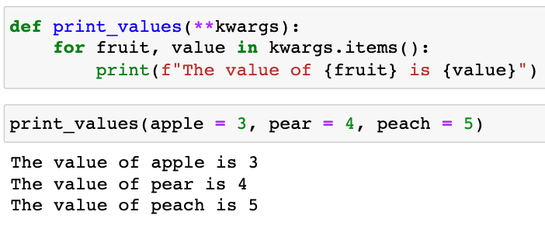
**kwargs

Slide 47
Scope and lifetime of variables
Python programs have two scopes （作用域）:
global（全局） and local （局部）
Global variable is accessible and modifiable throughout the program. A variable that is defined inside a function definition is a local variable
The local variable is created and destroyed every time the function is executed, and it cannot be accessed by any code outside the function definition.

Slide 48
Scope and lifetime of variables
To access the contents of a function variable from outside the function, the variable must be returned to the main program by using the return statement.
Global variables are accessible from inside a function, as long as you have not defined a local variable with the same name
A local variable can have the same name as a global variable, but they are totally different, so changing the value of the local variable has no effect on the global variable. Only the local variable has meaning inside the function in which it is defined

Slide 49
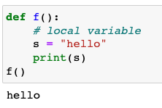
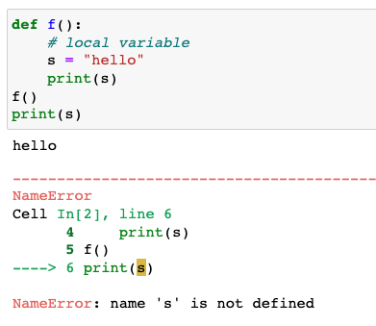
Scope and lifetime of variables

Slide 50
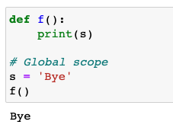
Scope and lifetime of variables
It is not recommended to access global variables from inside the definition of the function
If there is a need by function to access an external value, then it should be passed as a parameter to that function

Slide 51
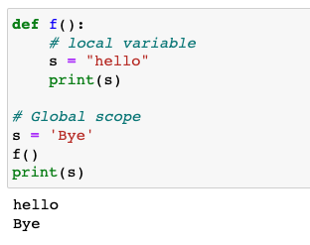
Scope and lifetime of variables

Slide 52
Scope and lifetime of variables

Slide 53
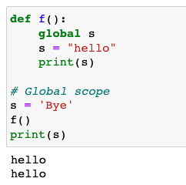
Scope and lifetime of variables
A global keyword is a keyword that allows a user to modify a variable outside the current scope. It is used to create global variables in Python from a non-global scope, i.e. inside a function.

Slide 54
Scope and lifetime of variables
A function definition can be nested within another function definition
The inner function can use the arguments and variables of the outer function, while the outer function cannot use the arguments and variables of the inner function
The inner function definition can be invoked by calling it from within the outer function definition

Slide 55
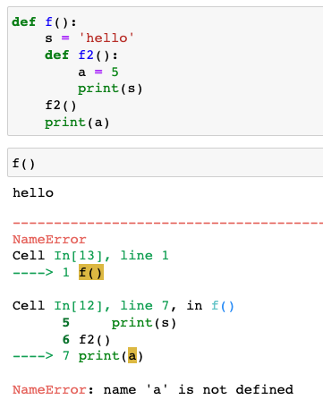
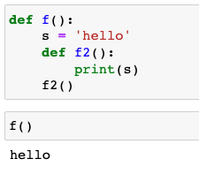
Scope and lifetime of variables

Slide 56
Recursion（递归）
Recursion generally means finding a solution to a problem by repeatedly solving the simpler versions of the same problem.
In programming, it is a process in which a function calls itself directly or indirectly.
def func_name(parameters):
…
…
func_name(updated parameters)

Slide 57
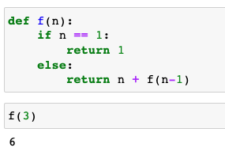
Recursion（递归）
Example of finding the sum of 1 to N (N>=1) using recursion:
f(1) = 1
f(n) = n + f(n-1)

Slide 58
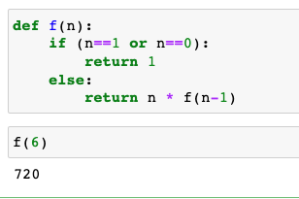
Recursion（递归）
Example of calculating factorial(阶乘) of number using recursion:
f(0) = 1
f(1) = 1
f(n) = n * f(n-1)

Slide 59
Anonymous functions: lambda expressions
A lambda expression is an in-line function that can be generated on the fly to accomplish small tasks, often where a function name is needed as input to another function:
add = lambda x, y: x + y
print(add(5, 3)) # 输出: 8
lambda arg1, arg2, ... : expression
>>> g = lambda a, b: 3*a + b**2
>>> g(2,3)
15

Slide 60
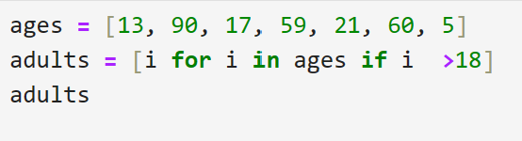
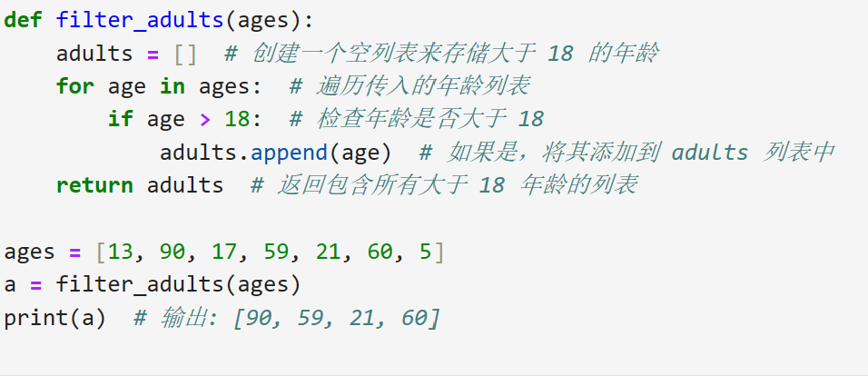
Example
Notes:
怎么变成一个函数呢？还有更简洁优雅的方式吗？

Slide 61
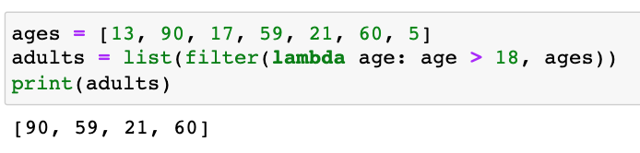
Examples of using lambda() Function : with filter()
The filter() function in Python takes in a function and a list as arguments. This offers an elegant way to filter out all the elements of a sequence “sequence”, for which the function returns True.

Slide 62
Examples of using lambda() Function : with filter()
The filter() function in Python takes in a function and a list as arguments. This offers an elegant way to filter out all the elements of a sequence “sequence”, for which the function returns True.

Slide 63
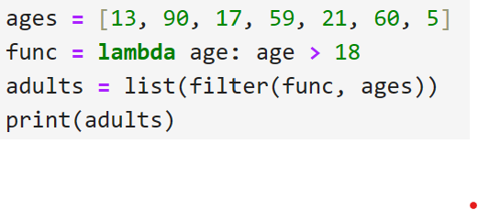
Examples of using lambda() Function : with filter()
The filter() function in Python takes in a function and a list as arguments. This offers an elegant way to filter out all the elements of a sequence “sequence”, for which the function returns True.

Slide 64
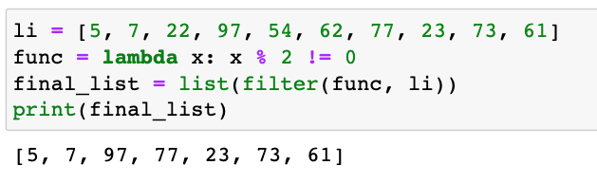
Examples of using lambda() Function : with filter()
The filter() function in Python takes in a function and a list as arguments. This offers an elegant way to filter out all the elements of a sequence “sequence”, for which the function returns True.

Slide 65
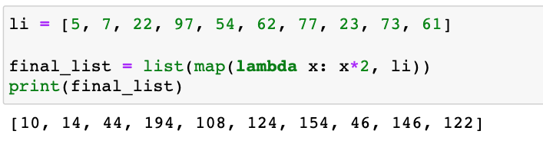
Examples of using lambda() Function : with map()
The map() function in Python takes in a function and a list as an argument. The function is called with a lambda function and a list and a new list is returned which contains all the lambda modified items returned by that function for each item

Slide 66
Modules and Packages
As your program gets longer, you may want to split it into several files for easier maintenance. You may also want to use a handy function that you’ve written in several programs without copying its definition into each program.
To support this, Python has a way to put definitions in a file and use them in a script or in an interactive instance of the interpreter. Such a file is called a module.

Slide 67
Modules and Packages
A module is a file with .py extension, which contains function definitions, constants, or any type of object that you can use from other modules or from your main program.
The name of the module is taken from the name of the file. If the module filename is my_module.py, the module name is my_module.

Slide 68
Using Modules
To access the contents of a module, use import.
It must be placed before calling any of the elements of the module.
It is customary, however, to place the import statement at the beginning of the program.
There are many ways to use import. The most used form is by calling a module by its name.

Slide 69


Using Modules
For example, to call the built-in module os:
Once a module is imported, to access a function or a variable,
use the name of the module as a prefix:

Slide 70
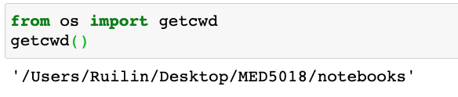
Using Modules
It is also possible to import from a module only a required function.
This way we can call it without having to use the name of the module as a prefix.

Slide 71
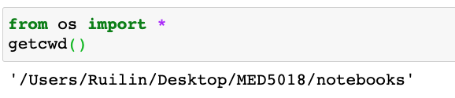
Using Modules
To import all the contents of a module, use the “*” operator (asterisk):
Warning: Don’t use the from module import * unless you know what you are doing. The problem with importing all the elements of the module is that it may produce conflicts with the names already defined in the main program

Slide 72
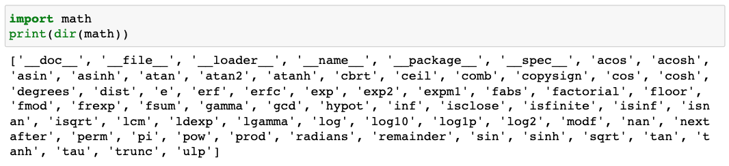
Using Modules
The built-in function dir() returns a sorted list of comma separated strings containing the names of functions, classes and variables as defined in the module

Slide 73

Using Modules
The help() function invokes the built-in help system:

Slide 74

Using Modules
It is also possible to import a module using a different name:

Slide 75


Using Modules
Custom modules
For example:
Use your favorite text editor to create a file called Mymodule.py
in the current working directory

Slide 76
Packages
A package is a group of modules with some characteristics in common.
They are directories with the modules or other directories inside.
Also contains a special file named __init__.py.
This file indicates that the directory it contains is a Python package and can be imported as a module.

Slide 77

Packages
For example, the Biopython package:
The __init__.py files are required to make Python treat the directories as containing packages.
In most cases, __init__.py is an empty file, but it can also execute initialization code for the package.

Slide 78

Packages
Users of the package can import individual modules from the package.
For example:

Slide 79
Installing Third-Party Modules/Packages
Follow the instructions of the modules that will be installed.
Using Anaconda:
conda install PACKAGE
Using pip:
pip install PACKAGE
For example, to install Pandas:
https://pandas.pydata.org/pandas-docs/stable/getting_started/index.html

Slide 80
Installing Third-Party Modules/Packages
pip
PIP is a package management system used to install and manage software packages written in Python
Install pip on windows:
Install pip on Mac

Slide 81
The main() function
If the source file is executed as the main program, the python interpreter sets the special built-in __name__ variable to have a value __main__.
If this file is being imported from another module, __name__ will be set to the module’s name. __name__ is a built-in variable which evaluates to the name of the current module.

Slide 82

The main() function
When the program is executed, the interpreter declares the initial value of __name__ as “__main__”.

Slide 83



The main() function
my_module.py is executed as the main program my_module.py is executed as a module

Slide 84
exercise
https://pynative.com/python-functions-quiz/
http://www.coolpython.net/python_primary/function/func_exercises.html

